Slide 1


Natural Language Processing
with
John Hogue | January 20, 2016

Slide 2



About Me
Data Scientist at General Mills
Supporting Marketing
Founder of Social Data Science
Crowd-sourced Data Science for Nonprofits
https://www.linkedin.com/in/johnhogue
https://github.com/dreyco676
@dreyco676

Slide 3

About Me (caveats)
NLP is only a part of my job
- Code written for readability
Not optimization
- I don’t know everything ☺
- But that’s ok

Slide 4
Agenda
- What is NLP?
- Why Spark?
- What is Spark ML?
- Which algorithm to use?
- How to prepare data for ML?
- How to measure accuracy?
- Where to go from here?
Text
Classification
Example

Slide 5

What is Natural Language Processing?
http://www.dlsi.ua.es/~elloret/

Slide 6
Natural Language Processing
Studies interactions between Computers & Human Language
How would a computer summarize a book?
How does a person ask a computer a question?
How does a computer understand speech?

Slide 7

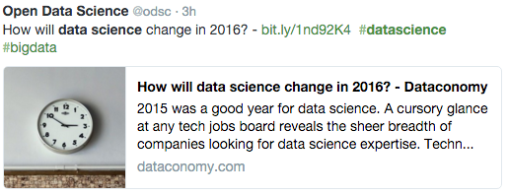
Tonight’s Example
Less of this
More of this
Notes:
Compare to Spam filtering

Slide 8
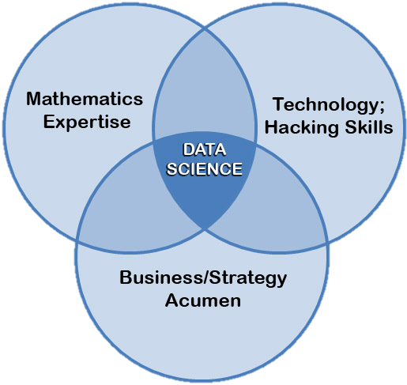


Tonight’s Text Classification Example
blah, blah, blah, blah, blah, blah, blah, blah, blah, blah, blah, blah, blah, blah, blah, blah, blah, blah, blah, blah, blah, blah, blah, blah, blah, blah, blah, blah, blah, blah, blah, blah, blah, blah, blah, blah, blah, blah, blah…
Data Science
Something else…
Notes:
Compare to Spam filtering

Slide 9

Tonight’s Data Set Corpus
Public Tweets
Everyone I follow on Twitter
149,254 Tweets Documents
Used Twython to access Twitter API
Used Hive for JSON parsing

Slide 10
Why
100x faster than MapReduce
Ideal for rapid data exploration
Great for high iteration machine learning
Code in what you know
Functional programming more suited for datasci
NLP Preprocessing ideal for parallel processing
Industry Interest
Quickly becoming a core datasci tool
Standardized ways of working with data

Slide 11

Why
Access to great libraries
NLTK
Langid
“First Class” language on Spark
Scala implementation first, Python follows
Data wrangling; less verbose is better
What’s Available in PySpark?
http://spark.apache.org/docs/latest/api/python/index.html
Replace ‘latest’ with your version Ex 1.6.0
Notes:
Talk about downsides
-horrible debugging
-some features lag
-speed

Slide 12
MLlib
MLlib Pro’s
Stable
More Algorithms Available
MLlib Con’s
Uses RDD’s
Lower Level
What’s Available in PySpark?
http://spark.apache.org/docs/latest/api/python/index.html
Replace ‘latest’ with your version Ex 1.6.0

Slide 13
ML
ML Pro’s
Abstracted to Dataframes
Easy to tune
ML Con’s
Very New, API’s change
Stability & Documentation
Few Examples
What’s Available in PySpark?
http://spark.apache.org/docs/latest/api/python/index.html
Replace ‘latest’ with your version Ex 1.6.0

Slide 14
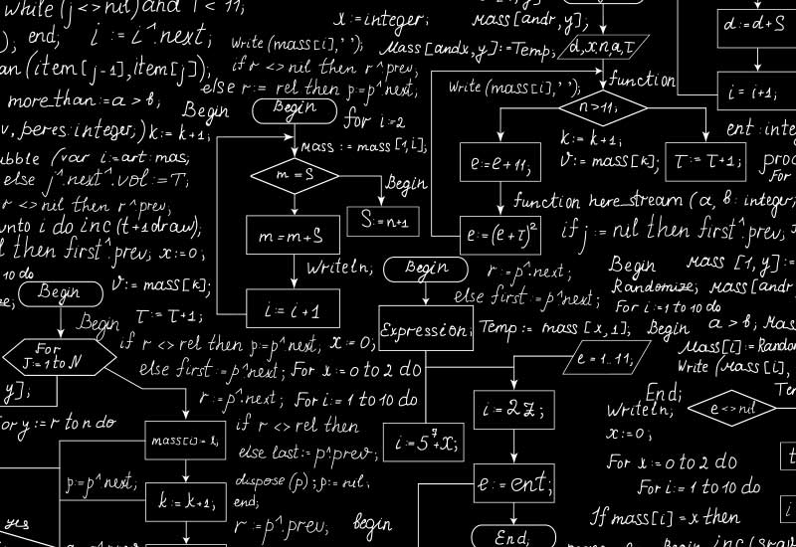
Which Algorithm?

Slide 15


Slide 16
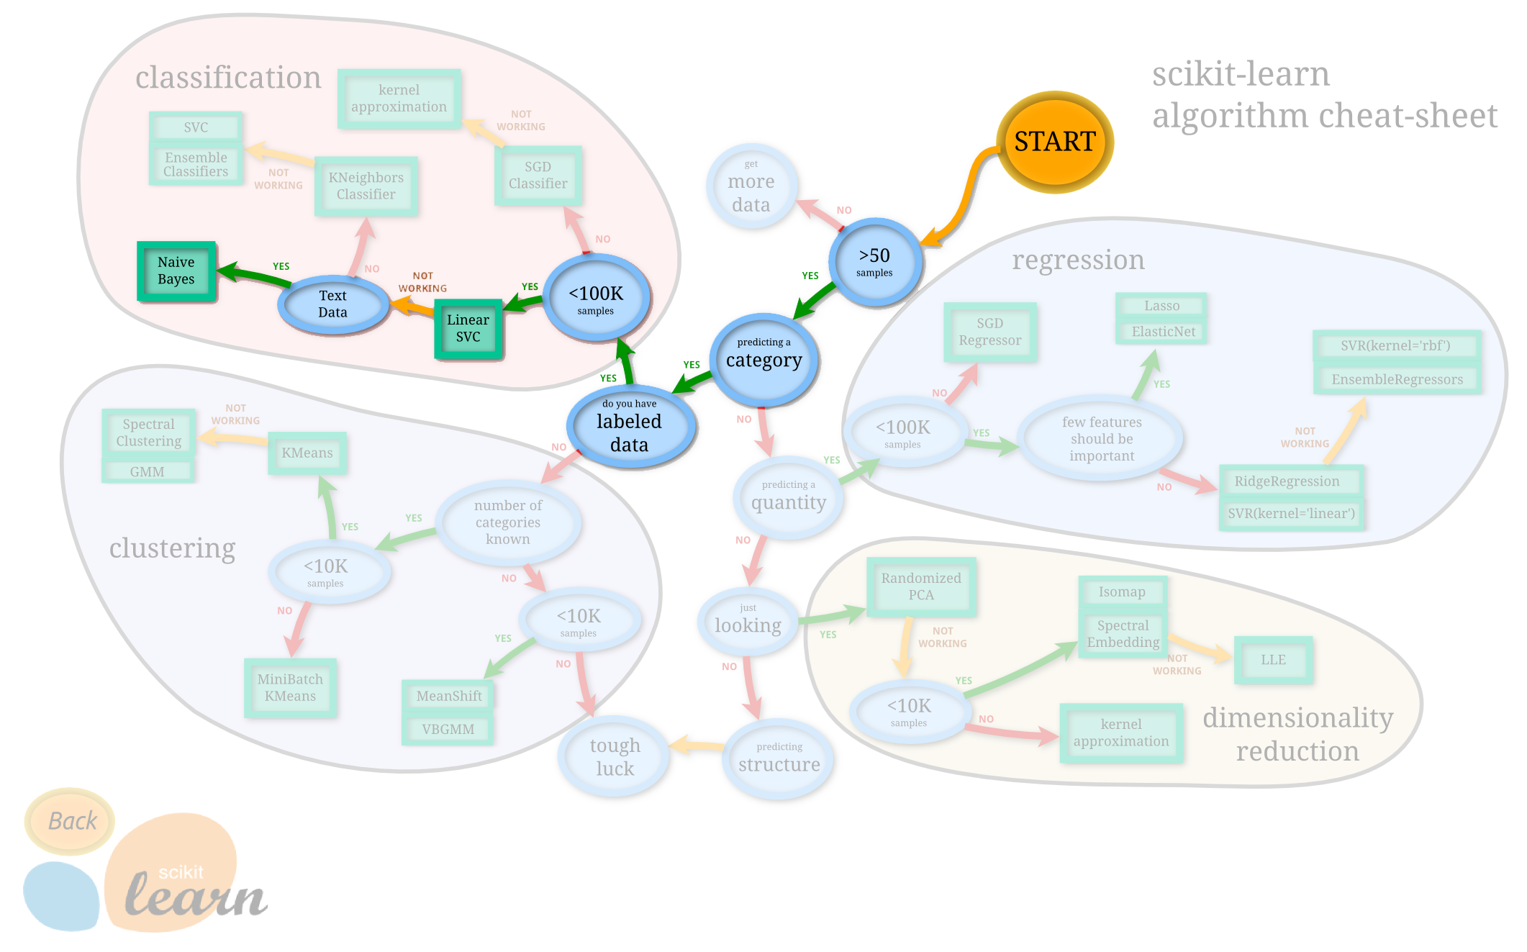

Slide 17
Naïve Bayes
This is Hadoop User Group; not math class
Detailed mechanics found here: Naive Bayes text classification - The Stanford NLP
Input
DataFrame
Id
Label
Numerical Vector
Output
DataFrame
Id
Predicted Label

Slide 18
DataFrames
Similar to:
Table in a relational database
Python Pandas DataFrame
R data.frame
Distributed under the hood
Named and Typed Columns
No more remembering array indexes!

Slide 19
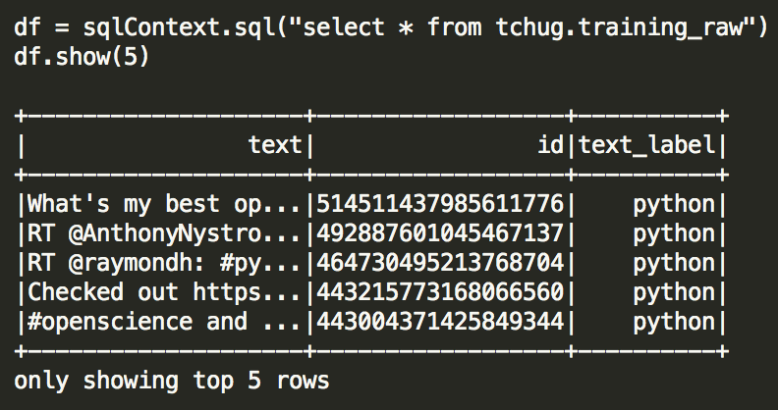
DataFrames
Creating a DataFrame from Hive is simple
Just need Hive configured correctly

Slide 20
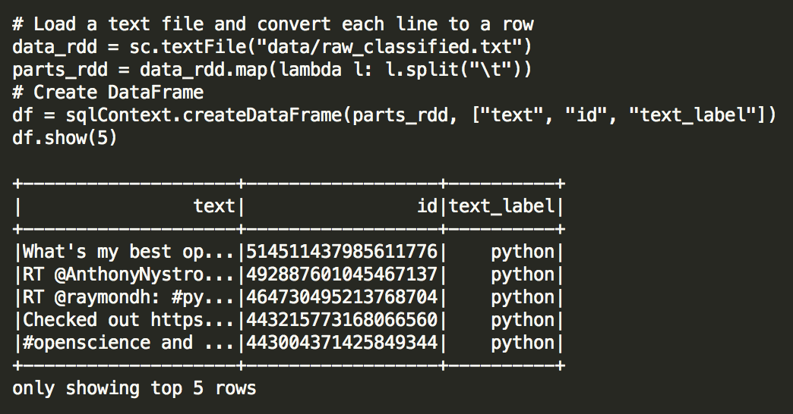
DataFrames
Creating a DataFrame from text file is a bit harder
Check out Data Bricks for a better way: https://github.com/databricks/spark-csv
This could also be a location in HDFS

Slide 21
Preprocessing Text Data
Need to simplify text into only its most important components
Humans are inefficient communicators…
Differs by application of NLP and corpus
Trial and error often are necessary
Most Preprocessing can be done in parallel!

Slide 22
Preprocessing
Natural Language Tool Kit (NLTK) http://www.nltk.org/
Amazing full fledged library
Multi-language support
Toy Datasets
Pythonic
langid https://github.com/saffsd/langid.py
Small library that classifies language of text
Pythonic

Slide 23

Managing Libraries in Hadoop
Local Python Interpreters on each node
Install shared libraries to Edge Node
Make Linux Share available to all nodes
Put all support files for the libraries in the share!

Slide 24
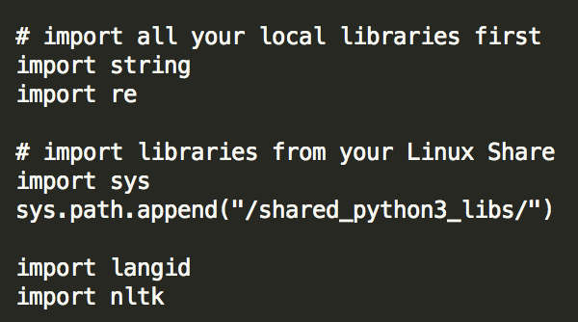
Managing Libraries in Hadoop

Slide 25
Filtering Language
A lot of the following steps are language specific
Twitter only reports the language of their Menu
Users may speak multiple languges
Clean Up
Return Language of Tweets with 90% certainty
Filter down to only English

Slide 26
Before / After

Slide 27
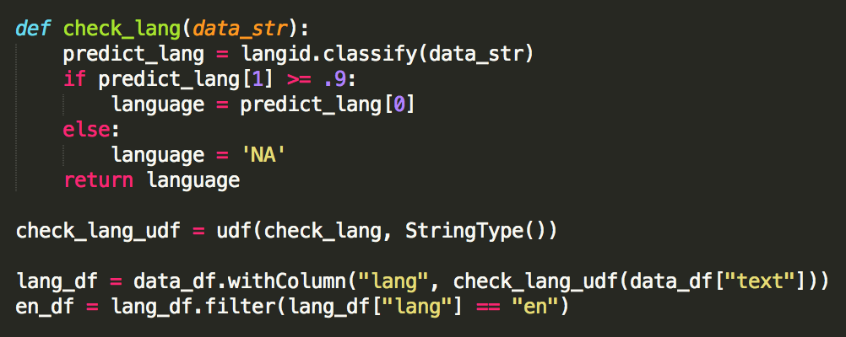
Custom Functions in
Normal Python function
Executed on a single Executor
Registering it with udf() distributes it across cluster
Requires DataType()
withColumn() creates a new column
Issues with in place operations…

Slide 28
Note about DataFrames…
Better to create a new DataFrame
WAY slower to do in place
Easier to make a changes on the fly

Slide 29
Removing Stop Words

Slide 30
Before / After

Slide 31
Removing Misc Junk

Slide 32
Before / After

Slide 33
Keeping only the important stuff

Slide 34
Before / After

Slide 35
Standardizing Words
Lemmatization

Slide 36
Before / After

Slide 37
Clean Up
Remove rows that have nothing left!
Dedupe your training set
RT or @mention people identical tweets
Duplicates can adversely impact models

Slide 38

It looks like you have text and not numerical data.
Would you like help?
Yes
No

Slide 39
The Label

Slide 40
Data Pipelining

Slide 41
Featurization

Slide 42
Training

Slide 43
Evaluating

Slide 44
Saving Data & Model

Slide 45
Next Steps? LDA?

Slide 46
Visualizing Data

Slide 47
Where to go from here?
github

